Slide 1
Are you Ready?
Kimberly Ellison-Taylor, CPA, CGMA, CISA
Past Chairman, American Institute of CPAs
Executive Director – Finance Thought Leadership
Oracle Cloud Business Group

Slide 2


Slide 3


Slide 4






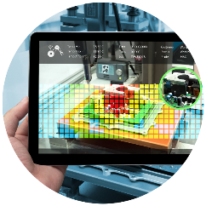
Tech-powered profession
?
Cloud
computing
Virtual assistants
Artificial
intelligence
Big data and
analytics
Robotic process automation
Blockchain
Augmented and virtual reality

Slide 5




External forces driving change …
Globalization
geopolitics
Demographic changes
Customer empowerment
Technology
automation

Slide 6




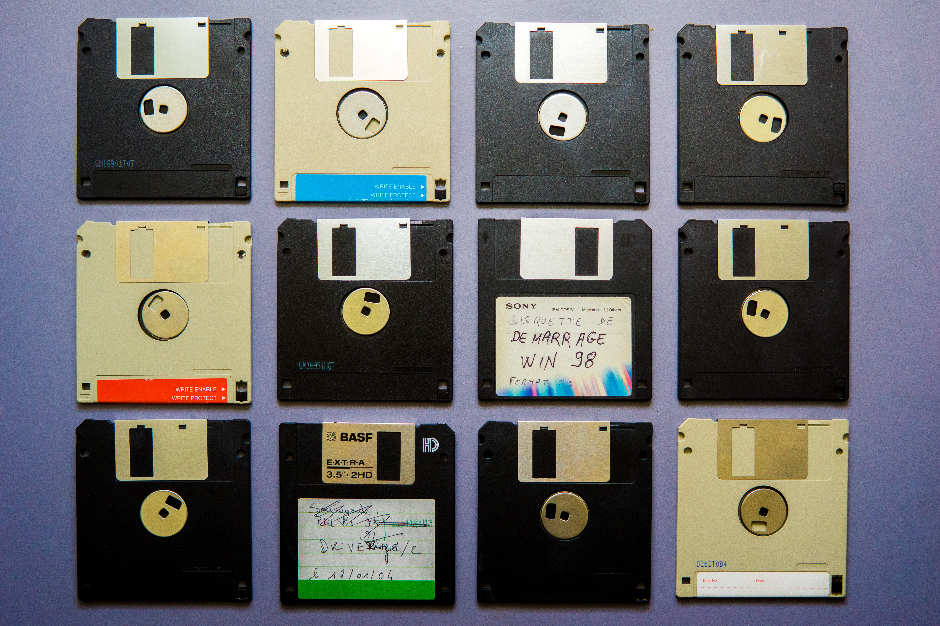







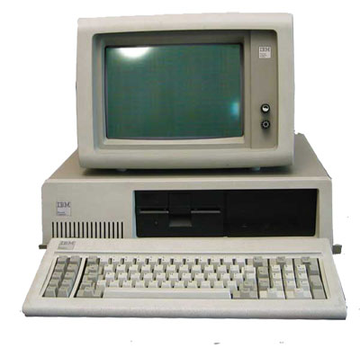

Slide 7
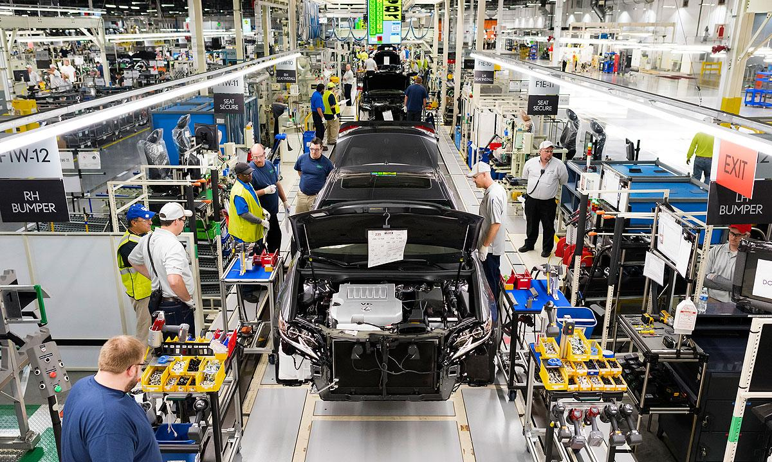

Slide 8
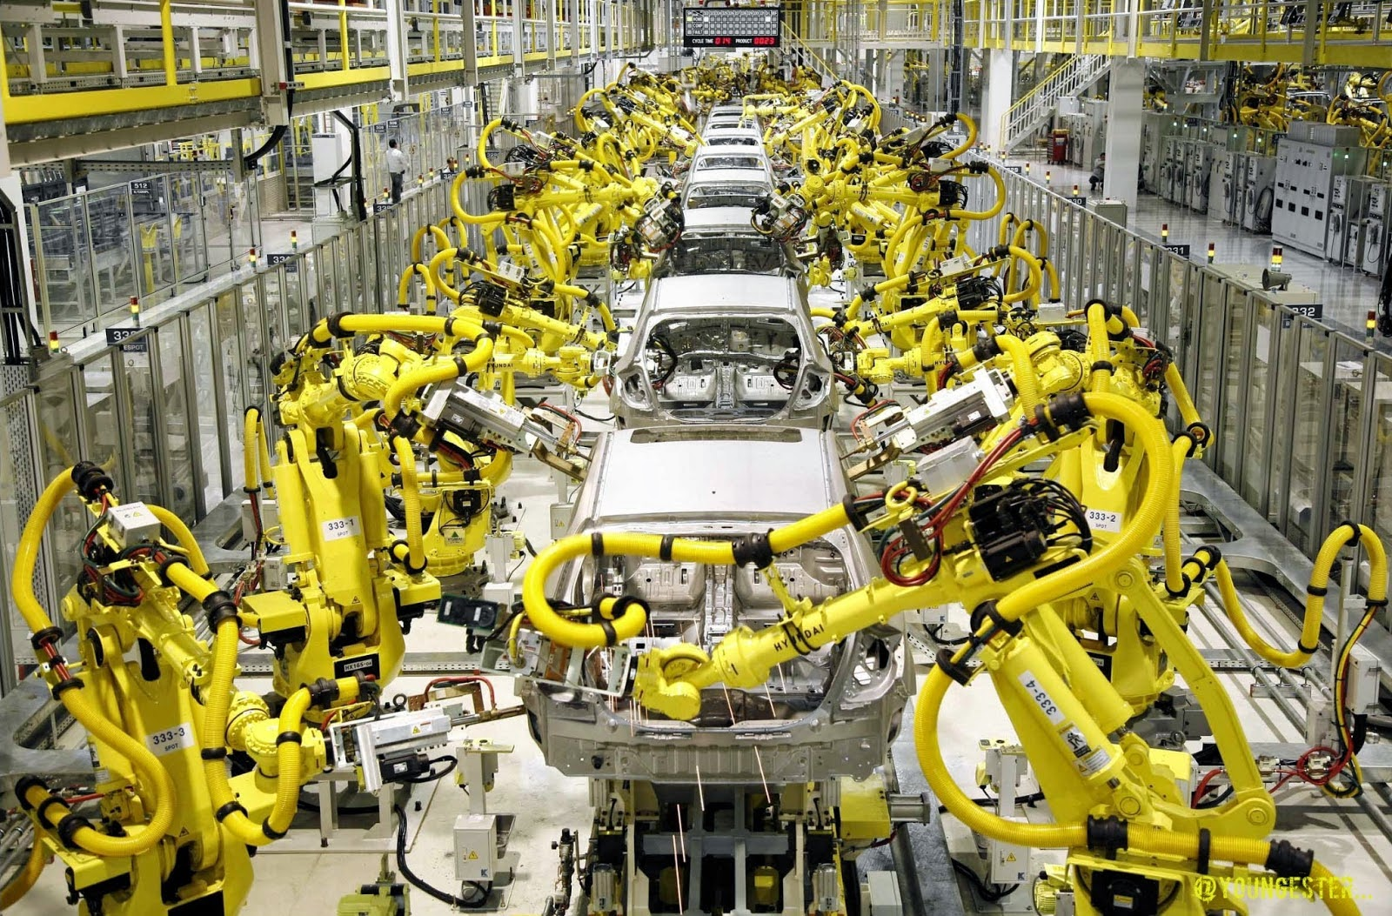

Slide 9


Transformation

Slide 10

Challenges are Opportunities
Cyber Security
Risk
Management
Mergers/ Acquisition
Succession Planning
Disruptive/New
Technologies
Strategic
Planning
Business Model
& Strategy
Talent Management
Personal Financial
Planning
Reporting
System Implementation
Change Management
Regulatory Complexity
Client
Relationship Management
Geopolitical Instability
Workforce Changes
Supply
Chain
Data Privacy
Client Accounting Services
Social Responsibility
Tax
Audit
Advocacy

Slide 11

IF YOU’RE NOT DISRUPTING,
YOU’RE BEING DISRUPTED

Slide 12

Technology Enables Transformation and Disruption
Artificial Intelligence
Blockchain
Big Data
Machine Learning
Internet of Things
Robotics Process Automation

Slide 13
Are You Ready?

Slide 14
Audit

Slide 15
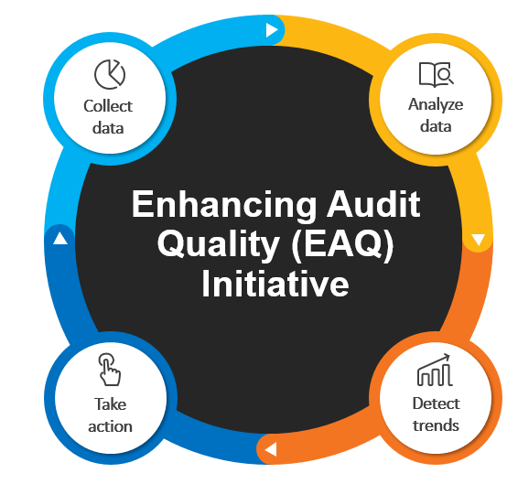
Audit quality
2019 focus areas
  Risk Assessment
  Internal Control
  Auditing Estimates
  Audit Documentation
  System and Organization Controls reports
aicpa.org/EAQ

Slide 16

Innovating the audit
Technology
Methodology
Standards
New skills

Slide 17
OnPoint PCR: Preparation, Compilation & Review solution
Guided
engagements
Integrated data
Cloud platform
Intelligent checklists
Interactive methodology
Automated financial
statements
Data visualization
Real-time collaboration
Security

Slide 18
Tax

Slide 19
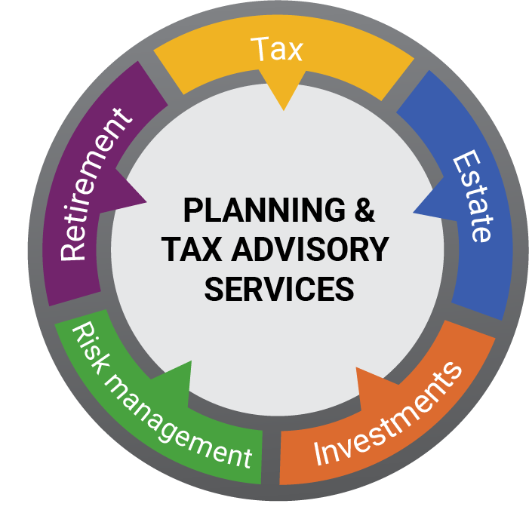
Planning & tax advisory services
Formalize services to integrate tax and planning for individuals
  Planning & Tax Advisory Services Hub
  Roadmap to Developing a Planning & Tax Advisory Services Business
Use resources to meet client needs
  Impact of Tax Reform on Planning Toolkit
  Analysis of a Tax Return for Financial Planning Opportunities
  Personal Finance Score Card
Strengthen skillsets with convenient learning options
  PFP Certificates
  PFS Credential
aicpa.org/taxreform | aicpa.org/growadvisoryservices

Slide 20
Advisory

Slide 21

Emerging areas
Cybersecurity Risk Management
  Cybersecurity Risk Management Reporting Framework
  Certificate programs
  SOC for Vendor Supply Chain
Blockchain
  SOC1 and SOC2
  Certificate program
Integrated Reporting
  Certificate program
Sustainability
  Attestation guide

Slide 22
Cybersecurity risk management
IT leaders:
82%
80%
predict unsecured IoT
devices will cause a breach in their organization
say such a breach would be catastrophic
Source: Ponemon Institute, 2018

Slide 23

Cybersecurity
Build your knowledge
  Free learning: Facebook Live, blogs, podcasts
  Webcasts and conferences
  Certificate programs
Protect yourself
  Cybersecurity Risk Management Reporting Framework
  New 2018 CPA Cybersecurity Checklist
Expand your services and promote your value
  PCPS Exploring Cybersecurity Toolkit
  Reporting on an Entity’s Cybersecurity Risk
  Management Program and Controls
  CGMA Cybersecurity Risk Management Tool
  New Resources to help talk to your clients
aicpa.org/cybersecurity

Slide 24
Business & Industry

Slide 25
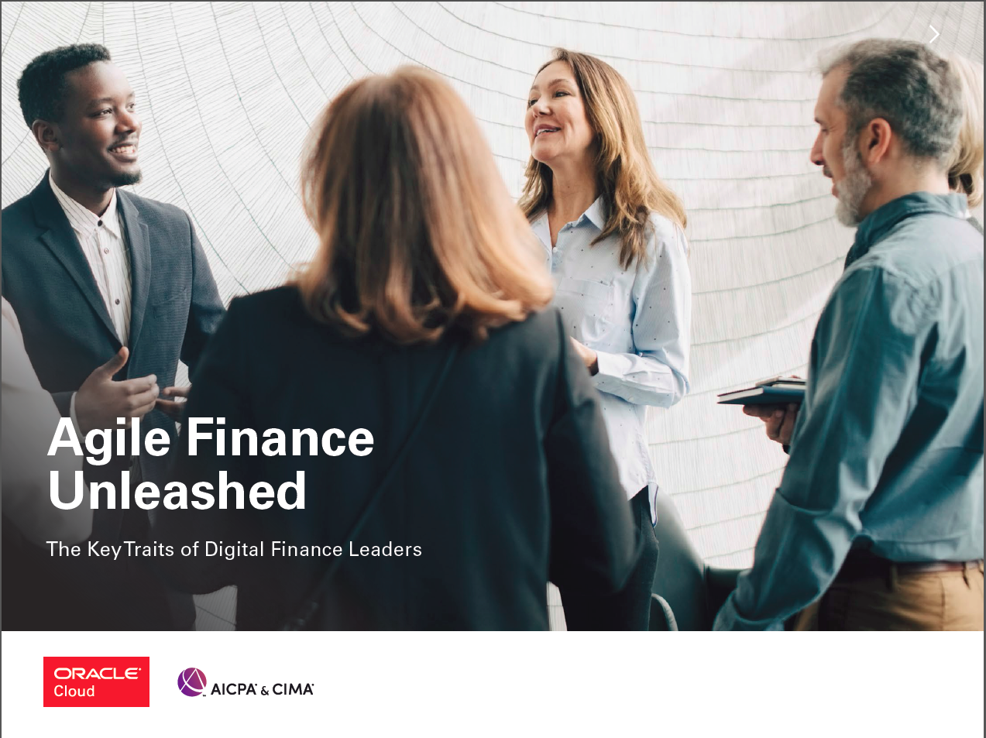
Agile Finance UNLEASHED
NEW
About the report
~700 Finance Professionals across
United States
Canada
Brazil
Mexico
United Kingdom
France
Germany
UAE
Saudi Arabia
Australia
Singapore
India
Japan
select sectors
Organization Leaders
2nd Survey conducted by the American Institute of CPAs (AICPA) and sponsored by Oracle
Finance Leaders Surveyed
-20% Chief Finance Officers
-23% Finance Directors, Chief Accounting Officers or Financial Controllers
Remainder – Senior Executives in finance including directors of Finance Transformation

Slide 26
Digital Finance Operating Model
Operational Excellence
Digital Intelligence
Business Influence
Driving process automation at scale, re-engineering legacy finance processes, and keeping a “digital-first,
cloud-first” mindset
Connecting data
enterprise-wide, using AI
to uncover hidden patterns,
and gaining a clear view of which data has the most
value to the business
Partnering with the business, using data-driven insights to recommend new courses of action, and influencing business strategy
Notes:
\

Slide 27
Operational Excellence
TRAITS OF DIGITAL FINANCE LEADERS
They prioritize the re-engineering of legacy finance processes to transform finance efficiency
They have implemented robotic process automation at scale, focusing on automation of transactional tasks such as record-to-report
They are increasingly applying machine learning to further improve process efficiency and strengthen risk management and compliance

Slide 28
Digital Intelligence
TRAITS OF DIGITAL FINANCE LEADERS
They centralize subject-matter expertise, such as reporting, M&A, FP&A, in virtual centers of excellence
They have driven scalable deployment across the finance function of advanced analytics tools
They use predictive analytics and artificial intelligence to generate new insights
They have a clear view of what data has the greatest value to their organization and which has the
least value

Slide 29
Business Influence
TRAITS OF DIGITAL FINANCE LEADERS
They are widely recognized by business stakeholders for displaying commercial acumen and business understanding
They play a significant and influential role in partnering with other lines of business to help improve decision making and performance management

Slide 30

Take A step.
TRUST
Build on your expertise.
TALENT
Think broader.
TECHNOLOGY
Master it before it masters you.

Slide 31
1
0
1
Complex problem solving
2
Critical thinking
3
Creativity
Top
4
People management
skills in 2020
5
Coordinating with others
6
Emotional intelligence
New skill sets will be needed
7
Judgment and decision making
8
Service orientation
9
Negotiation
10
Cognitive flexibility
Source: World Economic Forum

Slide 32

Follow me on Twitter: @KellisonTaylor
Contact me:
Email: Kimberly.Ellison-Taylor@aicpa-cima.com
Phone: 410-299-0989
Optional photo
For additional information on AICPA services or resources:
Email: service@aicpa.org
Phone: 888-777-7077

